Slide 1
Intro to Agile
Codeology Tech Comm

Slide 2
Agenda/Overview
User Requirements/Stories
Testing Frameworks
Implementing Features
Refactoring
Code Review
(rinse and repeat)

Slide 3
Extremely toy scenario
Embedding a Google Calendar

Slide 4
Turning an idea into a “User Story”
(who)
(why)
(what)
As a Member of Codeology,
So that I am aware of upcoming events,
I would like easy access to our Google Calendar.

Slide 5
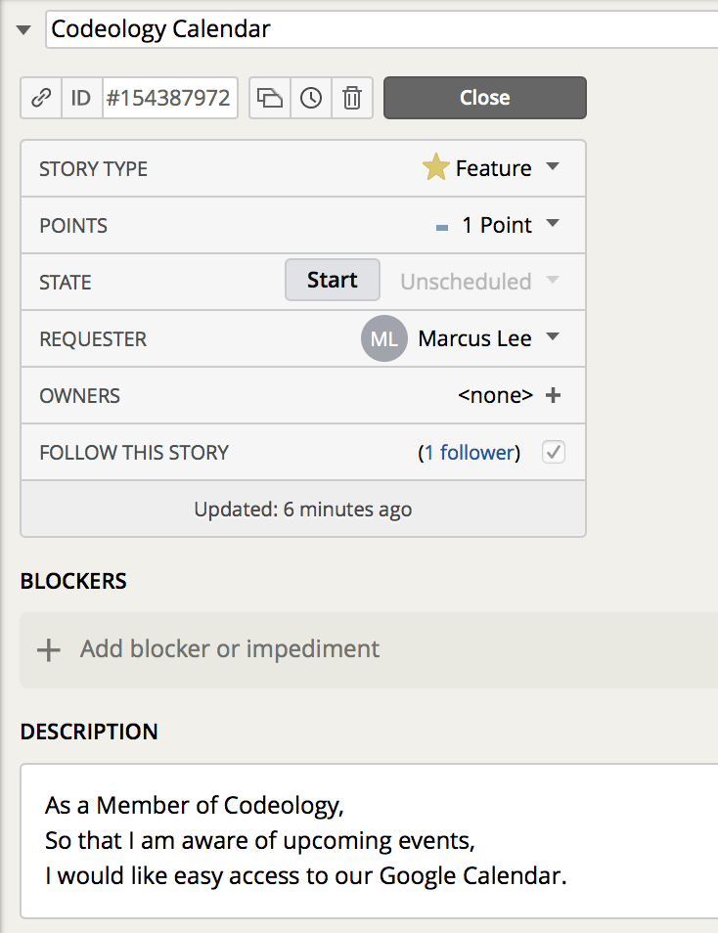
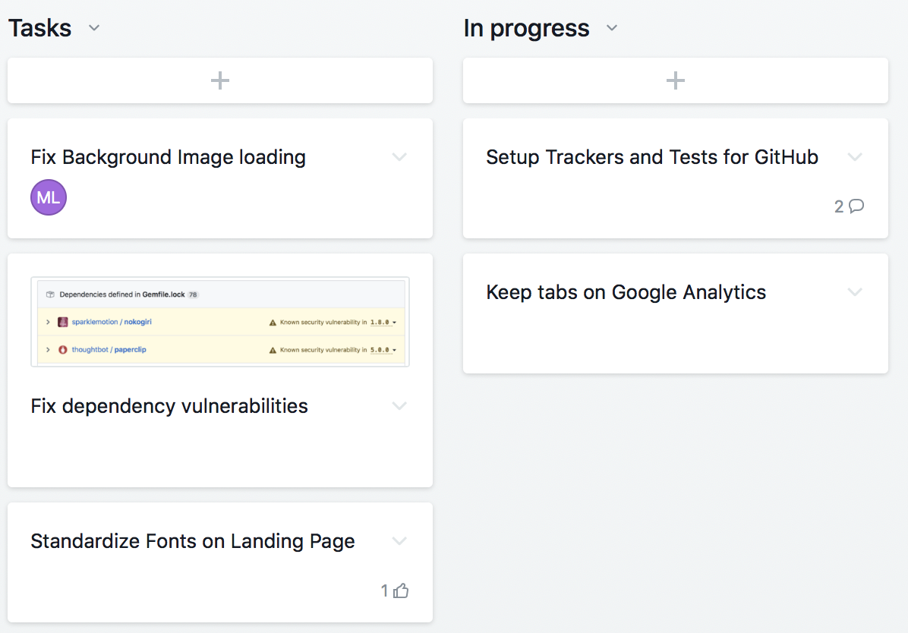
Managing User Stories
Pivotal Tracker:
Asana:

Slide 6
Model-View-Controller
How Ruby on Rails is organized as a framework

Slide 7
Model:
where data lives
(does not directly interact with each other)
Controller:
where interactions lives
View:
renders what users see

Slide 8
Visual Implementation: Lo-Fi mockups
Whiteboard/blackboard demo!

Slide 9
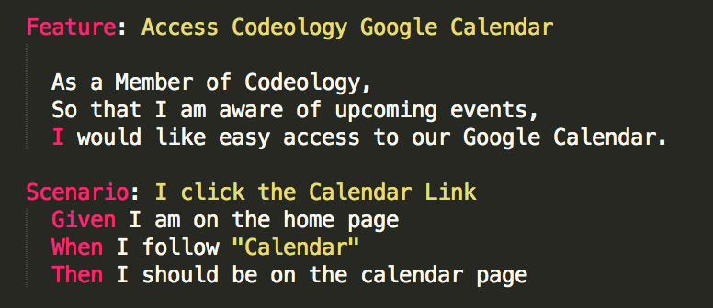
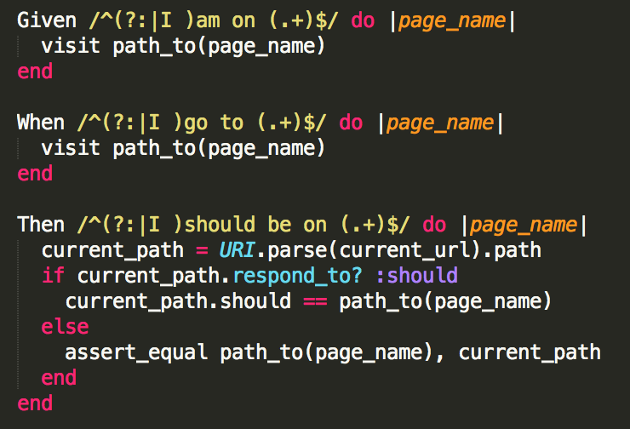
Behavior Driven Development – tl;dr simulate user behavior
Cucumber Feature file
Ruby Step Definition file
“convention over configuration” – give correct names and folder locations and Rails does the rest

Slide 10
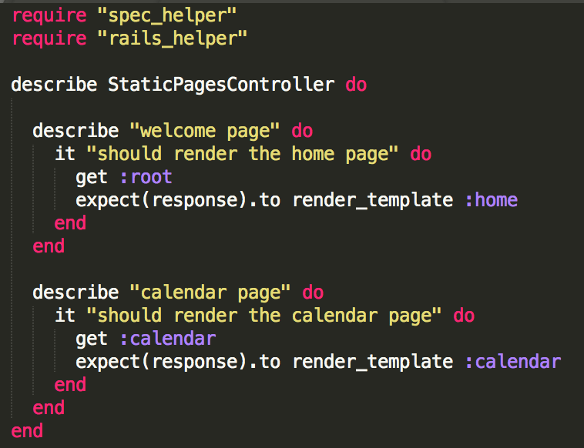
Test Driven Development - tl;dr make sure your implementation works
RSpec tests for model, controller

Slide 11
TIME TO IMPLEMENT!
yay more demo + Ruby on Rails crash course
after implementing, look for opportunities to simplify/refactor

Slide 12
Code Review
Fork your own branch on git
Develop the thing
Push back onto repo
Initiate pull request back onto master
Review, iterate, merge, done!

Slide 13
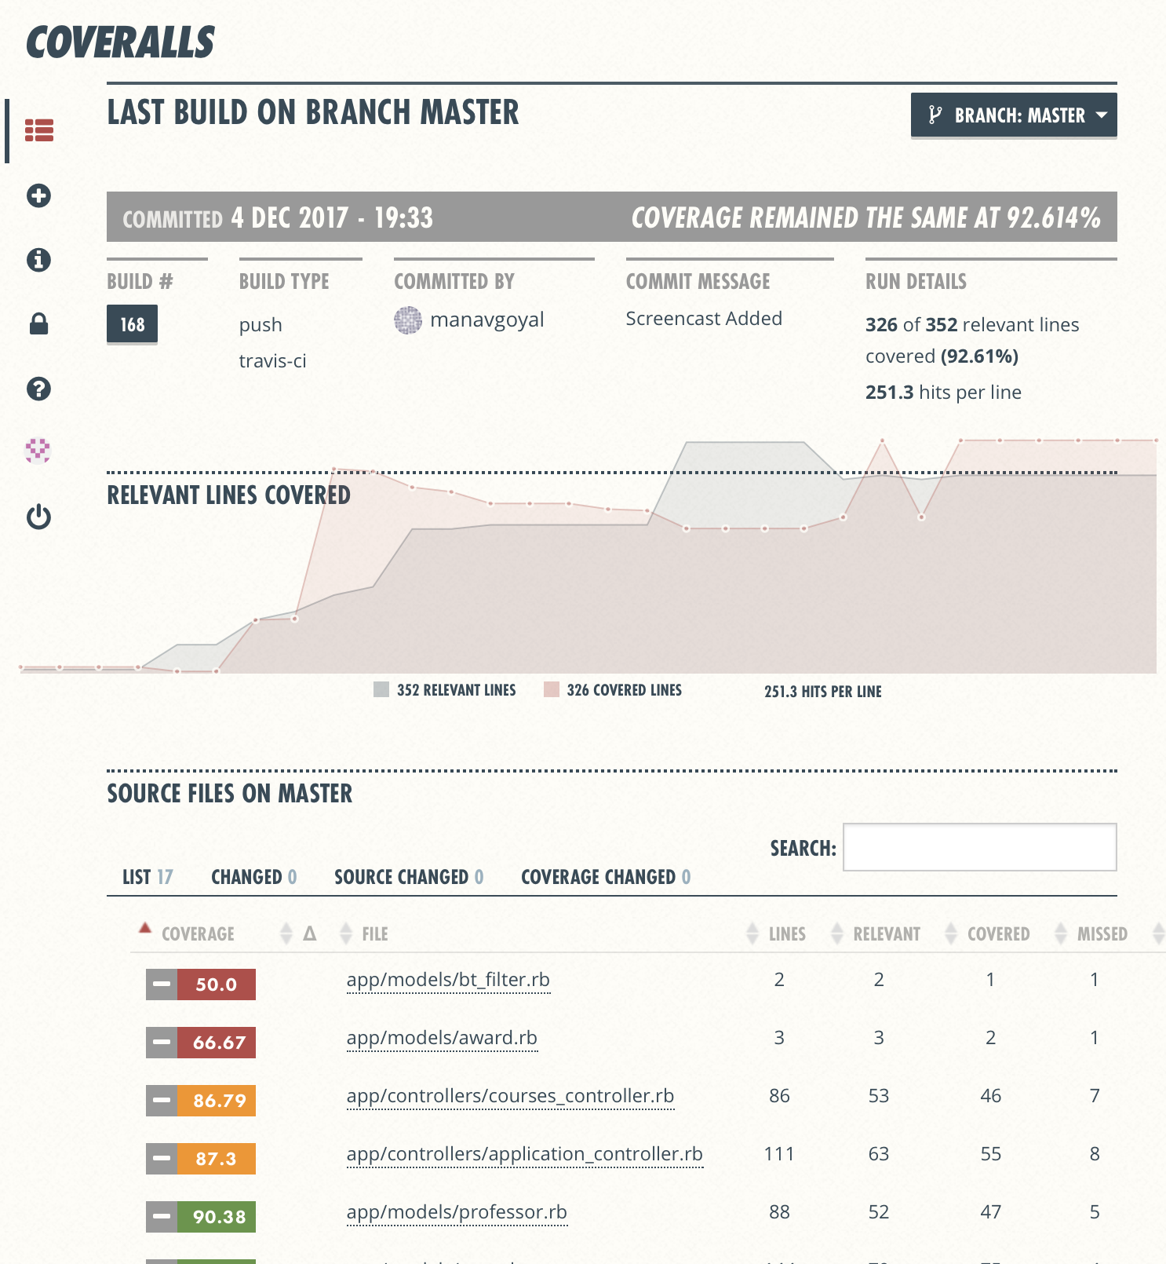
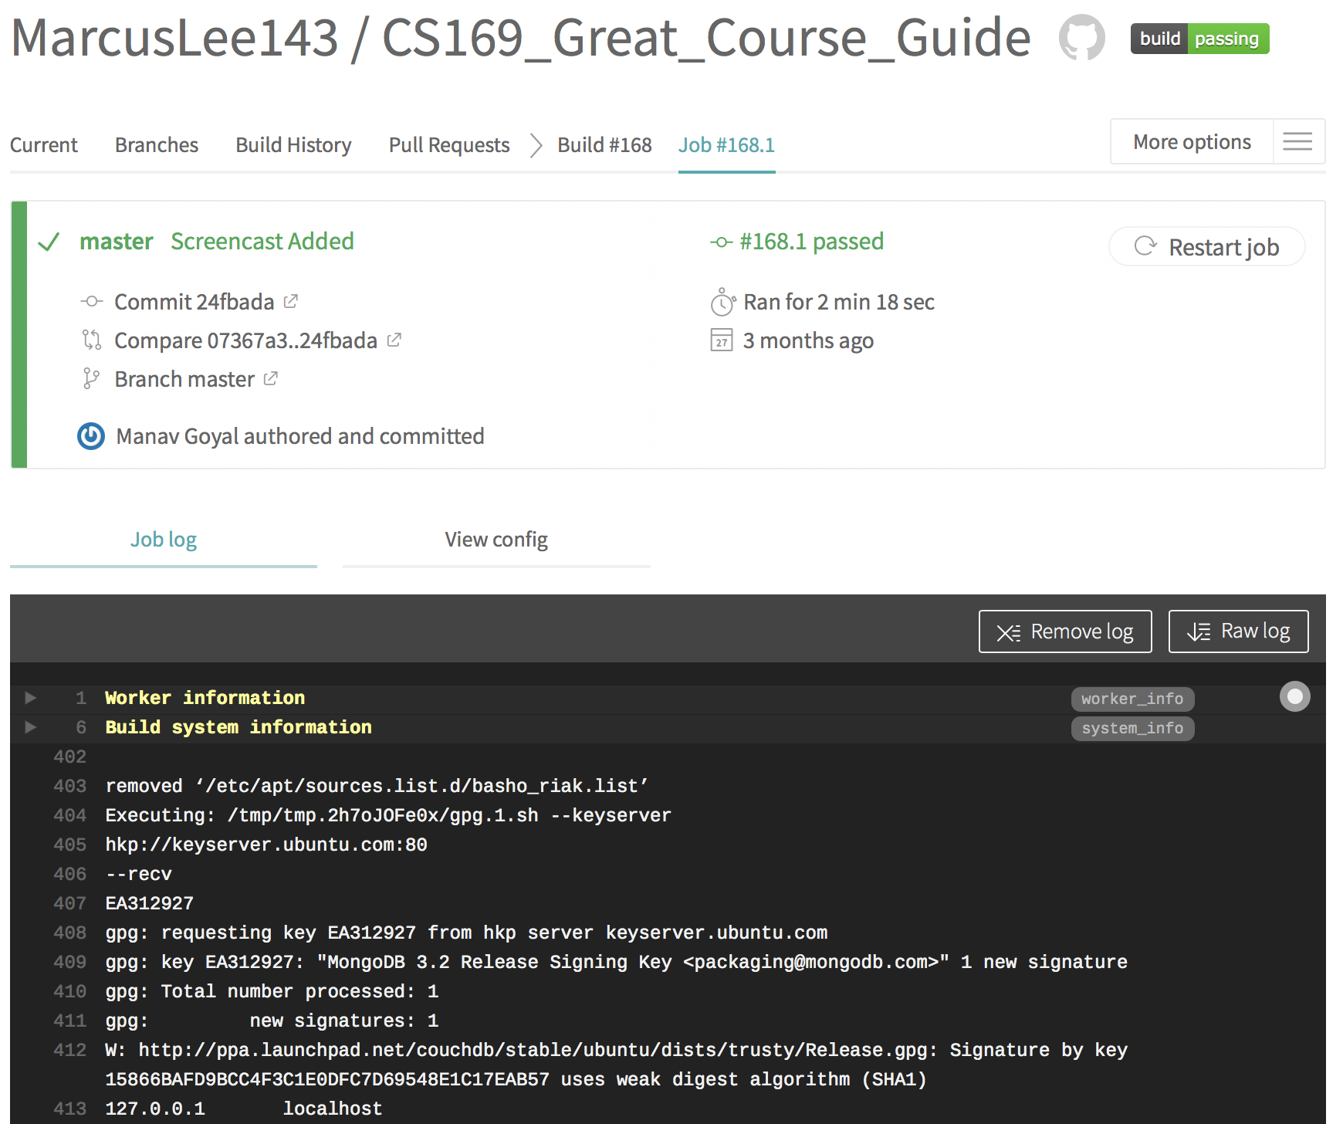
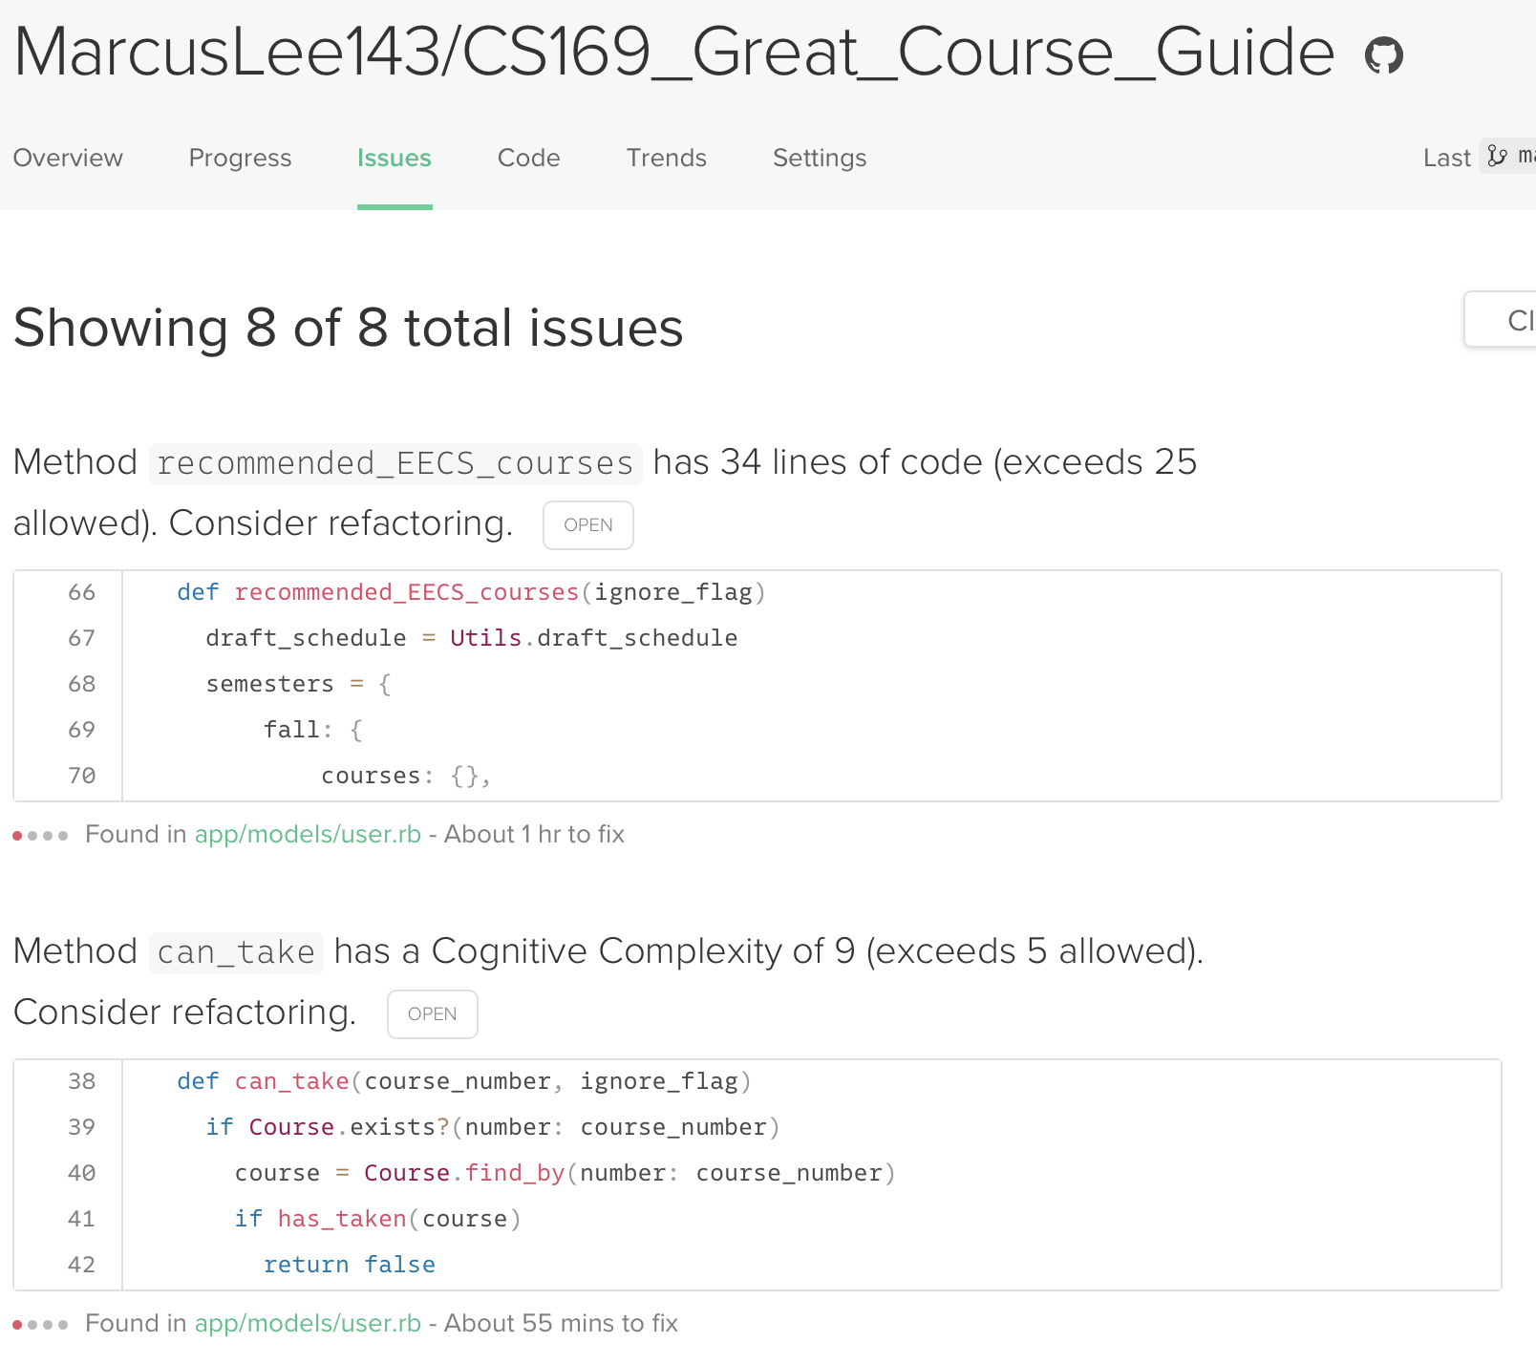
Bonus: Continuous Integration Testing
Tools to tell you where you done goofed and can improve things
Activates after pushing onto GitHub (not setup rn)

Slide 14
Thank you!

Slide 15
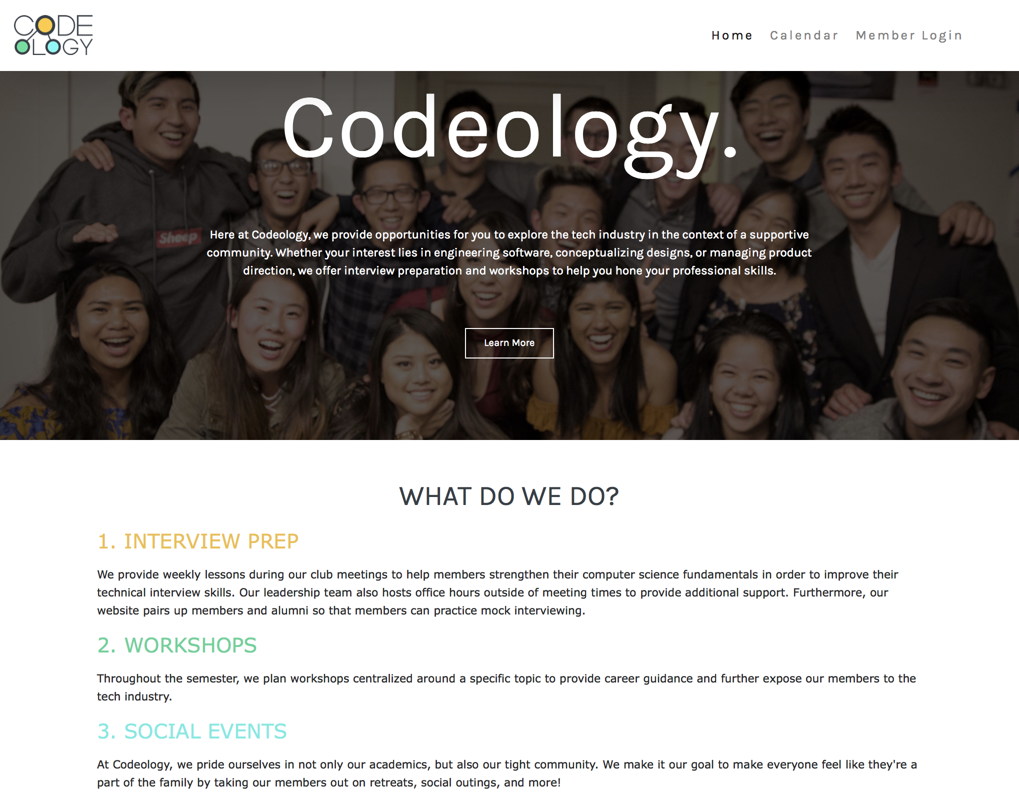
Next steps: project work!
Main bae: Codeology website
Look out for invites to GitHub + Pivotal Tracker
Start doin the thiiing

Slide 16
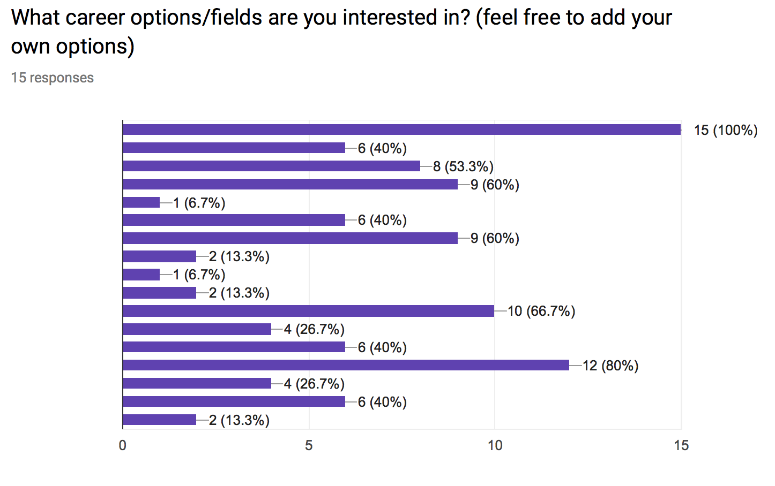
Side bae????
Top responses:
Software Engineering
AI
Machine Learning
Data Science
Video Games
Product Management
What if we combined all those things???

Slide 17
Accepting proposals for side projects!
Constraints:
Data focused (i.e. something that leverages data to answer a question/solve a problem)
Deliverables every week
Something you’re truly passionate about!
Reach out to me separately if you’re interested!

